Slide 1
Advanced C++
Chapter 12: Inheritance
Fall 2011
Kristina Shroyer

Slide 2
Chapter Objectives
In this chapter you’ll learn:
  To create classes by inheriting from existing classes.
  How inheritance promotes software reuse.
  The notions of base classes and derived classes and the relationships between them.
  The protected member access specifier.
  The use of constructors and destructors in inheritance hierarchies.
  The differences between public, protected and private inheritance.
  The use of inheritance to customize existing software.

Slide 3
Inheritance – The Is-A Relation
Another important relationship between classes in a program is the Is-A relation which is the relationship of inheritance
Many objects in the real world are specialized versions of more general objects
  An “insect” is a specialized version of the type “creature”
  A “grasshopper” and a “bumble bee” are specialized versions of the more general type “insect”
    Because grasshoppers and bumble bees are insects they both have the general characteristics of an insect
    In addition, they have special characteristics of their own
      Grasshoppers have jumping ability and bees have the ability to sting
These type of real world relationships between objects also apply to classes in object oriented programming
  A “Student” class could be a more specialized version of a “Person” class

Slide 4
Inheritance – The Is-A Relation
When one object is a specialized version of another object there is an Is-A relationship between them
  A poodle is a dog
  A car is a vehicle
  A rectangle is a shape
When an Is-A relationship exists between objects it means
  the specialized object has all of the characteristics of the general object plus additional characteristics that make it special
In object oriented programming, inheritance is used to create an Is-A relationship between classes

Slide 5
Inheritance – The Is-A Relation
Why is Inheritance useful?
  Software reusability
    Saves time during program development
    Encourages the reuse of proven, debugged, high quality software
      Increases the likelihood that a system will be implemented effectively
  Create new class from existing class
    Absorb existing class’s data and behaviors
    Enhance with new capabilities
So with inheritance instead of writing completely new data members and member functions for a class you can designate that the new class should inherit members of an existing class
  The Derived class inherits from base class
    So the existing class is the base class and the more specialized class is the derived class
      (in Java the base class is called the superclass and the derived class is called the subclass)
  Derived class
    More specialized group of objects
    Behaviors inherited from base class
      Can customize the inherited behaviors (specialization)
    Additional behaviors
      The derived class usually contains additional behaviors besides the inherited ones adding to the "specialization"

Slide 6
Inheritance – The Is-A Relation
This is a UML lite visualization of inheritance
Inheritance involves a base class and a derived class
  The base class is the general class
  The derived class is the specialized class
  You can think of the base class as the parent and the derived class as the child
INSECT
Base Class (parent)
-General Class
members
BEE
Derived Class (Child)
-Specialized Class
members

Slide 7
Inheritance – The Is-A Relation
Inheritance and the base and derived class properties:
  The derived class inherits the data members (attributes) and member functions of the base class
  New data members and member functions may be added to the derived class to make it more specialized than the base class
    Functions inherited from the base class may also be customized adding to the specialization
INSECT
Base Class (parent or superclass)
-General Class
members
BEE
Derived Class (Child or subclass)
-Specialized Class
members

Slide 8
Inheritance – The Is-A Relation
You can think of the classes involved in inheritance as being in a tree or hierarchy which illustrates their relationships to each other
  Direct base class
    Inherited explicitly (one level up hierarchy)
      Vehicle -> Car
  Indirect base class
    Inherited two or more levels up hierarchy
      UniversityCommunityMember->Employee->Faculty->Administrator
  Single inheritance
    Inherits from one base class
  Multiple inheritance
    Inherits from multiple base classes
      Base classes possibly unrelated
    This chapter focuses on single inheritance

Slide 9
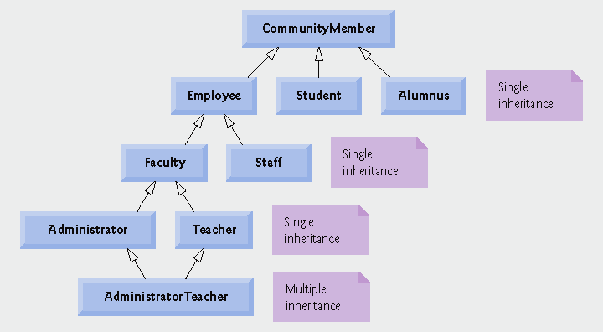
Inheritance Hierarchy Example
Inheritance Hierarch for University Community Members

Slide 10
Types of Inheritance - Intro
Three types of inheritance
  public
    Every object (instance) of derived class is also an object (instance) of base class
      Base-class objects are not objects of derived classes
      Example: All cars are vehicles, but not all vehicles are cars
    Can access non-private members of base class
    To access private base-class members
      Derived class must use inherited non-private member functions
      This means derived classes can NOT directly access private base class members
  private
    Alternative to composition
  protected
    Rarely used

Slide 11
Inheritance – Introduction cont.
Abstraction
  Focuses on commonalities among objects in system
  So with abstraction and object oriented programming we focus on the relationships between objects
    We focus on the commonalities rather than the special cases
“is-a” relationship vs. “has-a” relationship
  “is-a”
    Inheritance
    Derived class object can be treated as base class object
    Example: Car is a vehicle
      Vehicle properties/behaviors also apply to a car
  “has-a”
    Composition
    Object contains one or more objects of other classes as members
    Example: Car has a steering wheel

Slide 12
Inheritance – Introduction cont.
A derived class can access the non-private members of its base class
  Any base class members that should not be accessible to the member class functions of the derived class should be made private
Member functions of a derived class can NOT directly access private members of the base class.
  If a derived class could access its base class’s private members:
    Classes that inherit from that derived class could access that data as well
      This would allow access to what should be private data, and the benefits of information hiding would be lost.
  A derived class can change the states of private base class members but ONLY through non-private member functions provided by the base class and inherited into the base class

Slide 13
Base Classes and Derived Classes
Base classes and derived classes
Object of one class “is an” object of another class
  Example: Rectangle is a quadrilateral
    Class Rectangle inherits from class Quadrilateral
      Quadrilateral is the base class
      Rectangle is the derived class
Because every derived class "is an" object of its base class and one base class can have many derived classes this means:
  Base class typically represents larger set of objects than derived classes
    Example:
      Base class: Vehicle
        Includes cars, trucks, boats, bicycles, etc.
      Derived class: Car
        Smaller, more-specific subset of vehicles

Slide 14
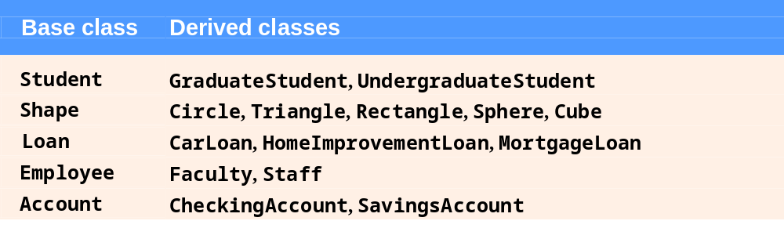
Inheritance Examples

Slide 15
Base Classes and Derived Classes
Inheritance hierarchy
  Inheritance relationships form a tree-like hierarchy structure
  Each class becomes
    Base class
      Supplies data/behaviors to other classes
    OR
    Derived class
      Inherits data/behaviors from other classes
Although classes can exist independently, once they become part of an inheritance relationship they become affiliated with other classes
UML with inheritance will resemble the hierarchy

Slide 16
Inheritance Hierarchy Examples
Each arrow represents an is a relationship.
  Starting from the bottom of the diagram you can follow the arrows and apply the is a relationship to the topmost base class
  So an AdministratorTeacher is a Administrator, is a Faculty member, is an Employee and is a Community member follow the path
  An Administrator Teacher is also a Teacher
Fig. 12.2 | Inheritance hierarchy for university CommunityMembers.

Slide 17
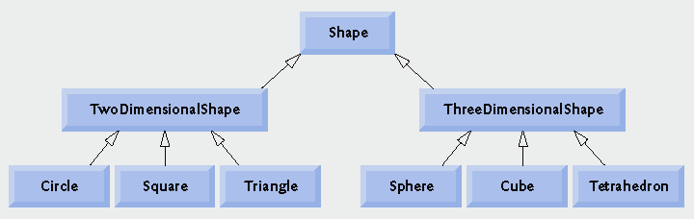
Inheritance Hierarchy Examples
Each arrow represents an is a relationship.
  This hierarchy could be expanded
Fig. 12.3 | Inheritance hierarchy for Shapes.

Slide 18
Specifying public Inheritance
class Student : public Person
Derived Class
Base Class
To specify the class Student is derived from the class Person, the Student class definition should begin like shown above
This is an example of public inheritance
  public inheritance is the most commonly used form of inheritance

Slide 19
public Inheritance
public inheritance
  Specify with:
  class TwoDimensionalShape : public Shape
    Class TwoDimensionalShape inherits from class Shape
With ALL forms of inheritance:
  private members of the base class are:
    NOT accessible directly from that class's derived class
    BUT these private base class members are still inherited (they are still considered parts of the derived class
      These private base class members can be:
        Manipulated through inherited public member functions
With public inheritance:
  All other base class members (other than private) retain their original member access when they become members of the derived class
    So public and protected members of the base class become public and protected members of the derived class
    Using these inherited base class members the derived class can manipulate private members of the base class
friend functions
  ARE NOT INHERITED

Slide 20
Protected Members
Up until now we have used two access specifications when we defined classes: private and public
  C++ provides a third class access specification: protected
Protected members of a base class are like private members except they may be accessed by:
  member functions and friends of a derived class.
Protected members of a base class may be accessed by:
  Base class members (so member functions of the base class)
  Base class friends
  Derived class members (member functions of a derived class)
  Derived class friends
Protected members are inaccessible to all other code not in the base class or derived class

Slide 21
Protected Members
Derived-class members
  Refer to public and protected members of base class by
    Simply using the protected member names directly
Derived classes can customize or redefine base class member functions, in this case:
  When base class member functions are redefined in the derived class, derived object instance calls to that function will call the derived class redefined version of the function
  Redefined base class member functions can be accessed though – they can be accessed from the derived class by:
    preceding the base class member name with the base-class name and binary scope resolution operator (::)
      This is the correct use of the scope resolution operator – not a lot of what I've seen in some people's programs (I've seen the incorrect use in people's programs when they are just trying to get he program to work instead of using object oriented principles)
  We'll discuss redefining members of the base class and using protected data using some examples

Slide 22
Examples Base Class & Derived Class
We're going to look at a series of examples involving the following two classes:
    CommissionEmployee
      First name, last name, SSN, commission rate, gross sale amount
      these employees are paid solely on commissions
    BasePlusCommissionEmployee
      First name, last name, SSN, commission rate, gross sale amount
      And also: base salary
      these employees get a base salary plus commissions
We're first going to look at these classes designed as two separate unrelated classes
We'll then look at them designed with inheritance
  Then we'll vary all of these to illustrate some key inheritance concepts

Slide 23
CommissionEmployee class
Example 1
  So first we'll create this class on it's own with no inheritance involved
Note validation was not done for the various private string members as they are manipulated through the constructor and set functions
  This was just for convenience purposes and in a real situation would be validated
This class works much like what we are used to and have been doing with our classes so far
  A client test program was also created

Slide 24
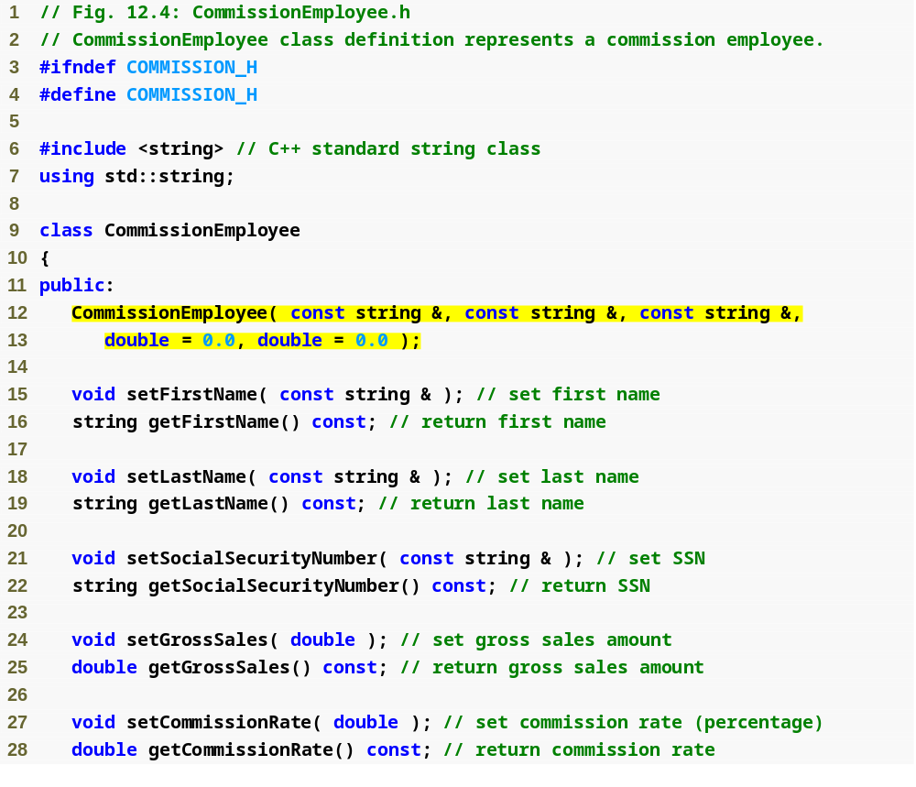
Example 1
Commission
Employee.h
(1 of 2)
Class CommissionEmployee constructor

Slide 25
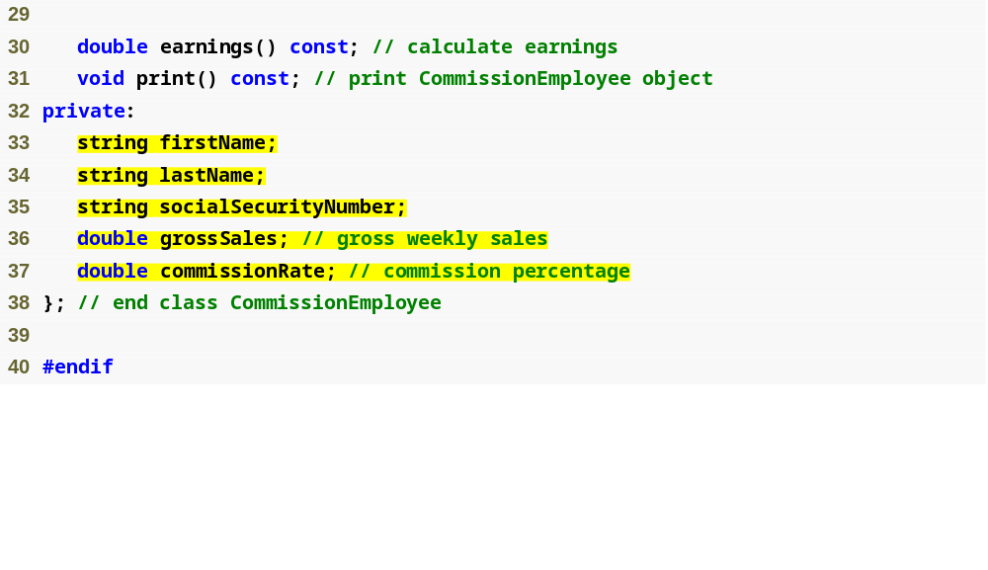
Declare private data members
Example 1
Commission
Employee.h
(2 of 2)

Slide 26
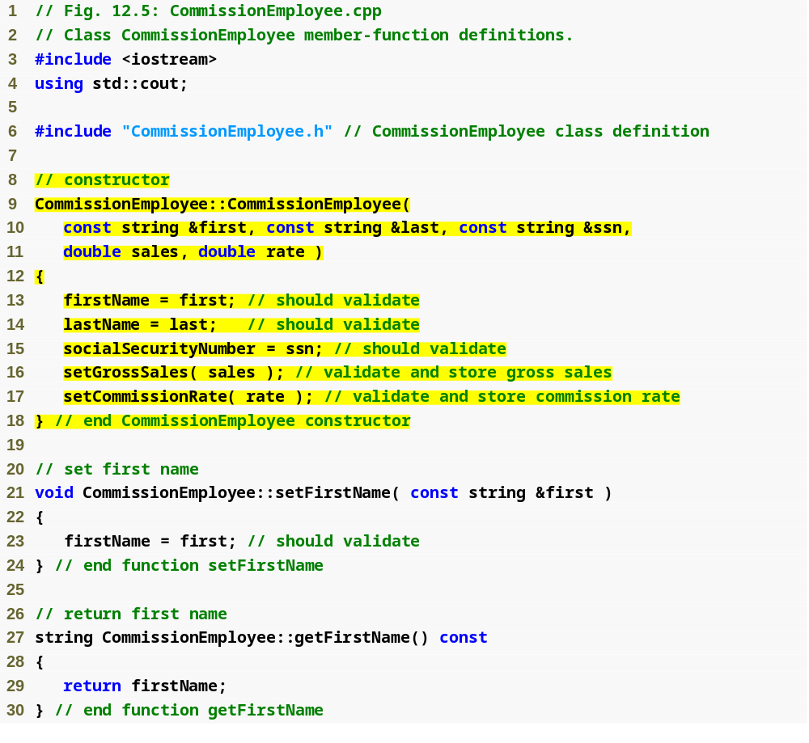
Initialize data members
Example 1
Commission
Employee.cpp
(1 of 4)

Slide 27
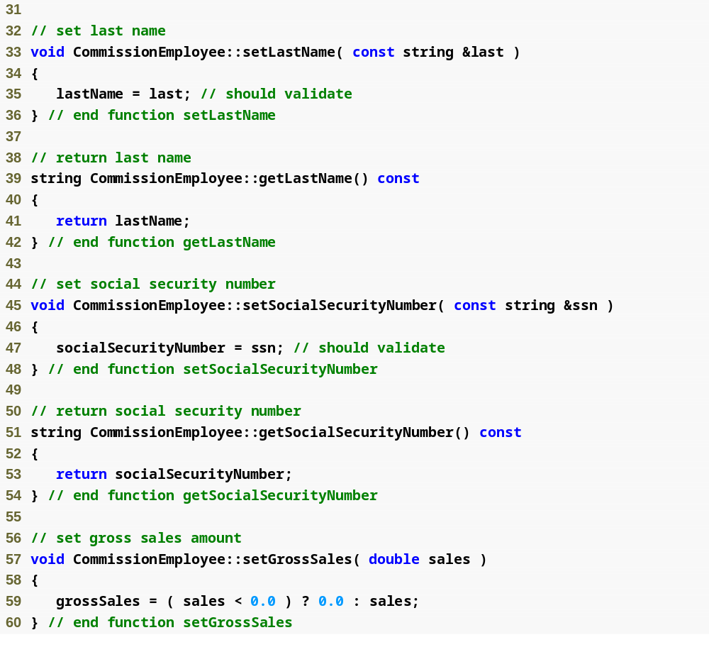
Example 1
Commission
Employee.cpp
(2 of 4)
Function setGrossSales validates gross sales amount

Slide 28
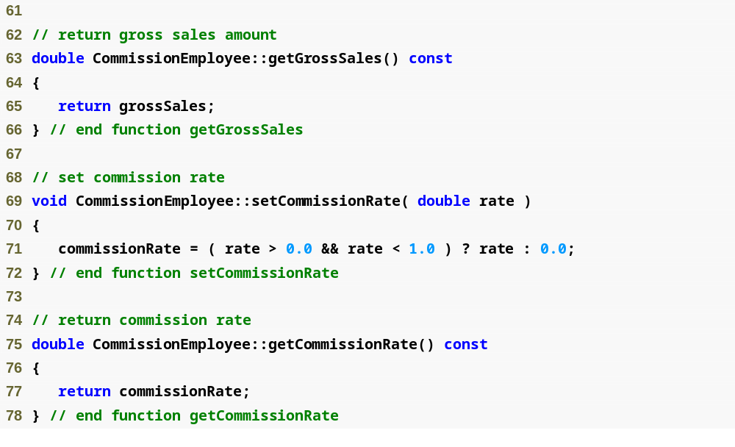
Function setCommissionRate validates commission rate
Example 1
Commission
Employee.cpp
(3 of 4)

Slide 29
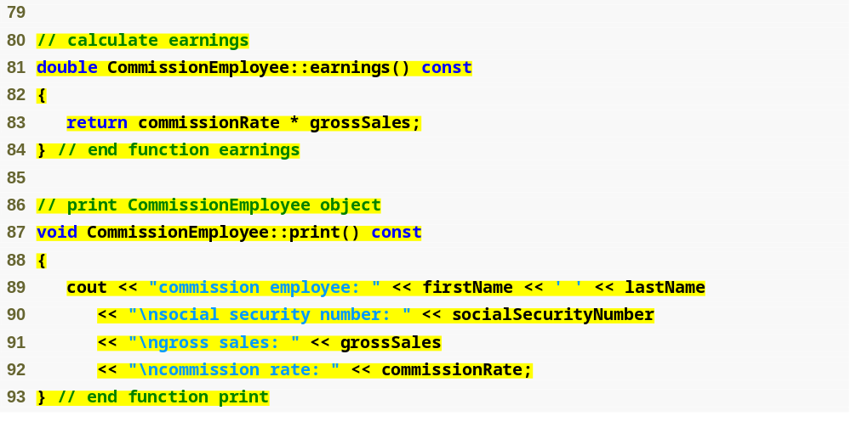
Function earnings calculates earnings
Function print displays CommissionEmployee object
Example 1
Commission
Employee.cpp
(4 of 4)

Slide 30
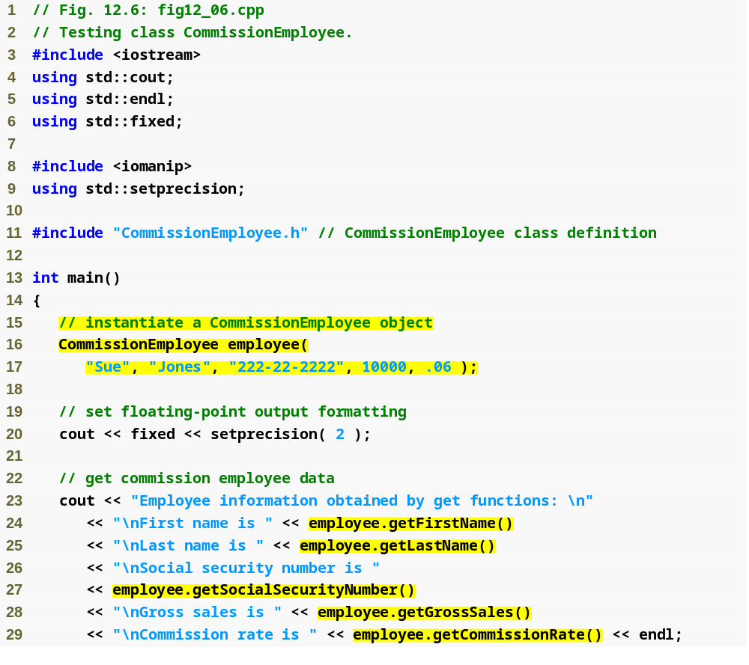
Example 1
testCommEmp.cpp
(1 of 2)
Instantiate CommissionEmployee object
Use CommissionEmployee’s get functions to retrieve the object’s instance variable values

Slide 31
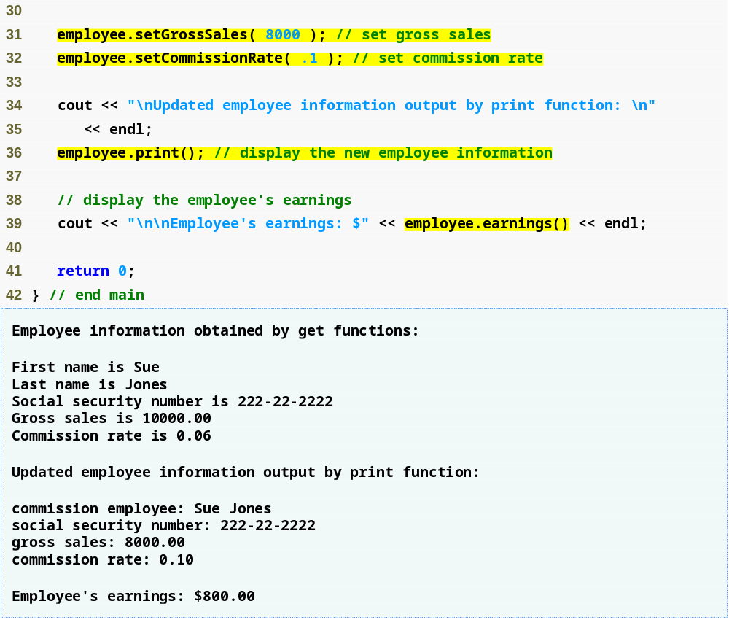
Use CommissionEmployee’s set functions to change the object’s instance variable values
Call object’s print function to display employee information
Call object’s earnings function to calculate earnings
Example 1
testCommEmp.cpp
(2 of 2)

Slide 32
BaseCommissionEmployee class
Example 2
  Now we're going to create a completely independent BaseCommissionEmployee class to show why inheritance is better for certain examples like this
  As we look at it note all the similarities between this class and the CommissionEmployee class
Class BasePlusCommissionEmployee
  Much of the code is similar to CommissionEmployee
    private data members
    public methods
    constructor
  Additions
    private data member baseSalary
    Methods setBaseSalary and getBaseSalary

Slide 33
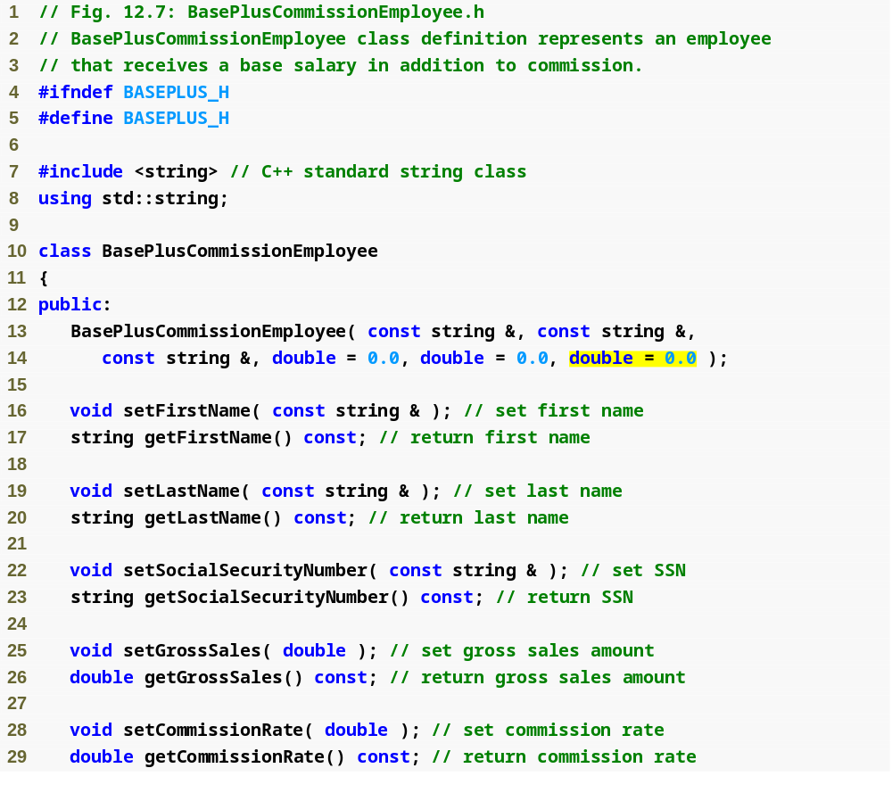
Example 2
BasePlus
Commission
Employee.h
(1 of 2)
Constructor takes one more argument, which specifies the base salary

Slide 34
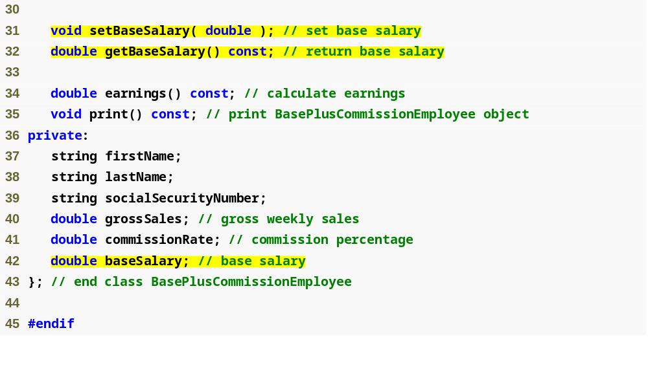
Define get and set functions for data member baseSalary
Example 2
BasePlus
Commission
Employee.h
(2 of 2)
Add data member baseSalary

Slide 35
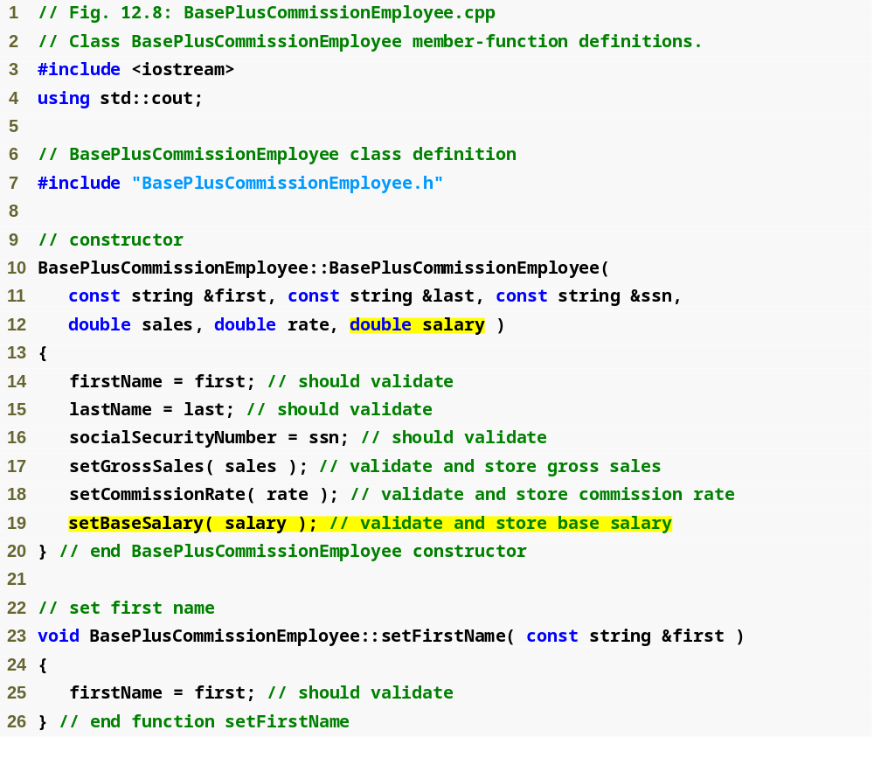
Example 2
BasePlus
Commission
Employee.cpp
(1 of 4)
Constructor takes one more argument, which specifies the base salary
Use function setBaseSalary to validate data

Slide 36
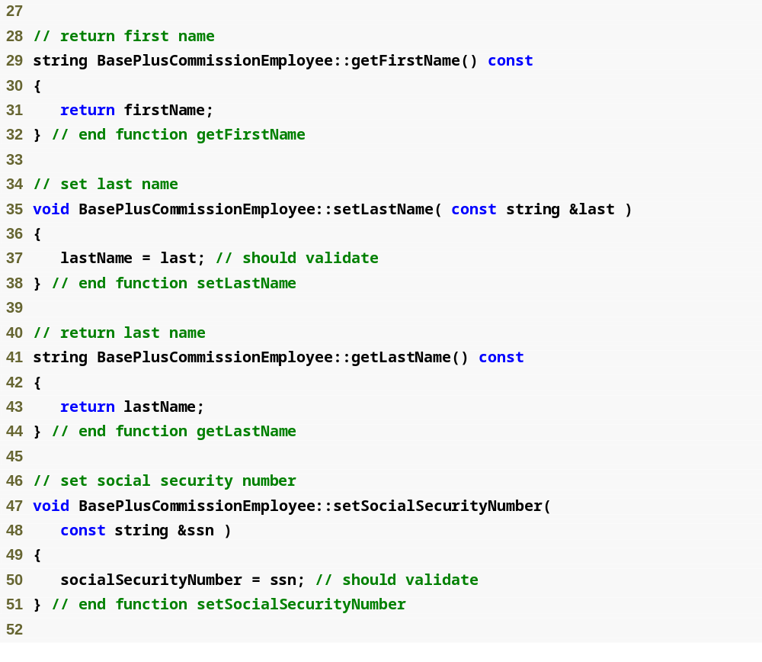
Example 2
BasePlus
Commission
Employee.cpp
(2 of 4)

Slide 37
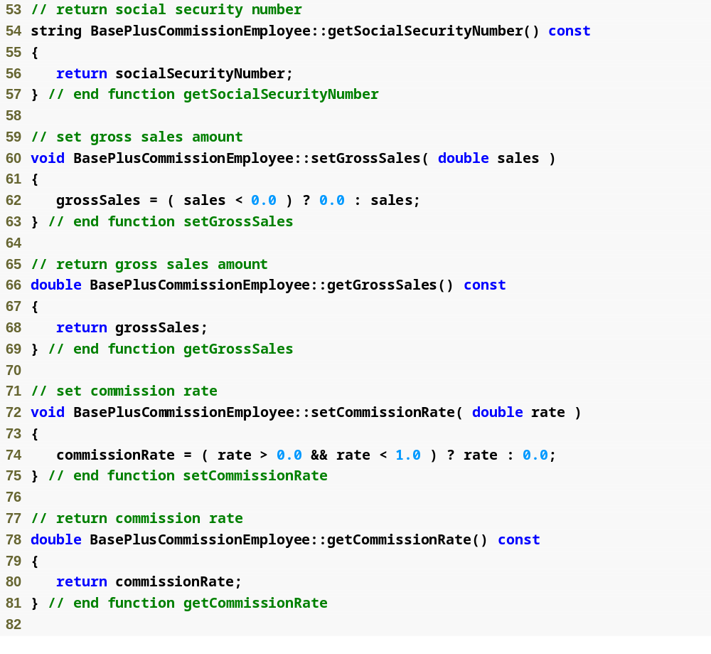
Example 2
BasePlus
Commission
Employee.cpp
(3 of 4)

Slide 38
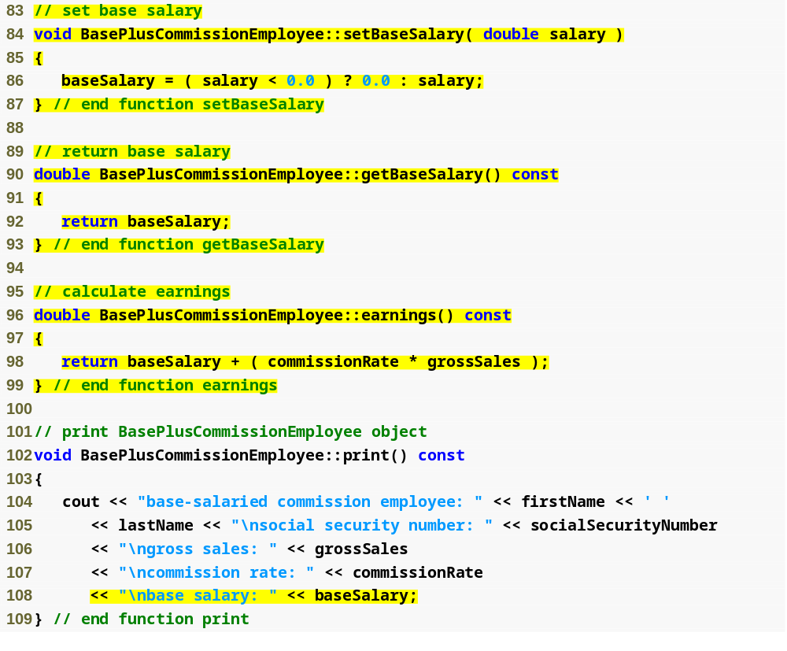
Function setBaseSalary validates data and sets instance variable baseSalary
Function getBaseSalary returns the value of instance variable baseSalary
Update function earnings to calculate the earnings of a base-salaried commission employee
Update function print to display base salary
Example 2
BasePlus
Commission
Employee.cpp (3 of 4)

Slide 39
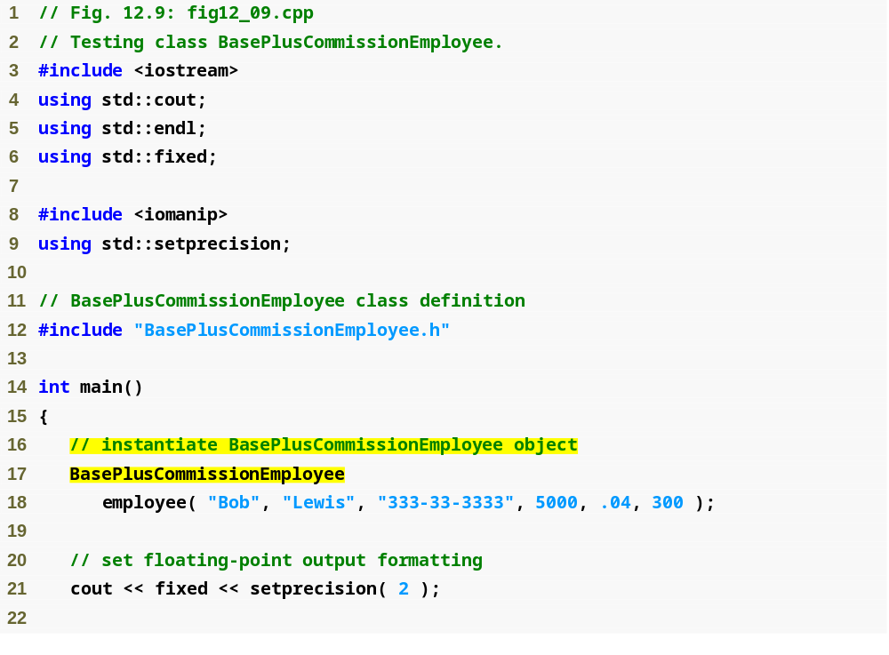
Example 2
testBase.cpp (1 of 2)
Instantiate BasePlusCommissionEmployee object

Slide 40
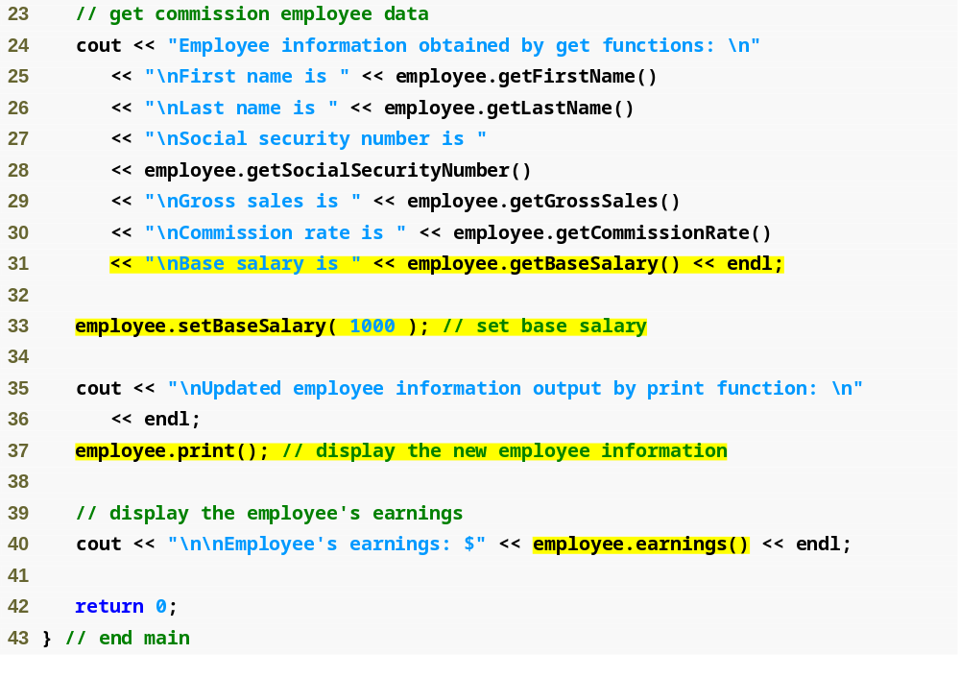
Use BasePlusCommissionEmployee’s get functions to retrieve the object’s instance variable values
Use BasePlusCommissionEmployee’s setBaseSalary function to set base salary
Call object’s print function to display employee information
Call object’s earnings function to calculate employee’s earnings
Example 2
testBase.cpp (1 of 2)

Slide 41
Similarities Example 1 & Example 2
There are more similarities than differences between the code for the CommissionEmployee class and the code for the BasePlusCommissionEmployee class
  These two classes are classes that a sales organization would likely need both of in their payroll system
When I created the BasePlusCommissionEmployee class I of course copied and pasted the CommissionEmployee class and then made the relevant changes
The problems with the copy/paste approach assuming one organization needs and uses both of these classes
  time consuming
  error prone, easy to miss changes and make mistakes
  spreads many physical copies of the same code throughout the system
    if you want to change something in the CommissionEmployee class that likely also affects the BasePlusCommissionEmployee class so maintenance is error prone and a large task
The solution to the problems with the copy/paste approach
  Inheritance

Slide 42
Software Engineering Observation
With inheritance, the common data members and member functions of all the classes in the hierarchy are declared in a base class.
  When changes are required for these common features, software developers need to make the changes only in the base class—derived classes then inherit the changes.
  Without inheritance, changes would need to be made to all the source code files that contain a copy of the code in question.

Slide 43
Inheritance First Attempt (Example 3)
Example 3
For this first attempt at Inheritance we are going to leave the CommissionEmployee class as is and attempt to rewrite BasePlusCommissionEmployee as a derived class of Commission Employee
  We're going to see there are a few problems with this approach and there are some changes to CommissionEmployee we should make for the inheritance
Class BasePlusCommissionEmployee
  Derived from class CommissionEmployee
    Is a CommissionEmployee
    Inherits all public members
  Constructor is not inherited/Destructor is not inherited as we'll see in a second
    Use base-class initializer syntax to initialize base-class data members
  Has an additional data member baseSalary (specialization)

Slide 44
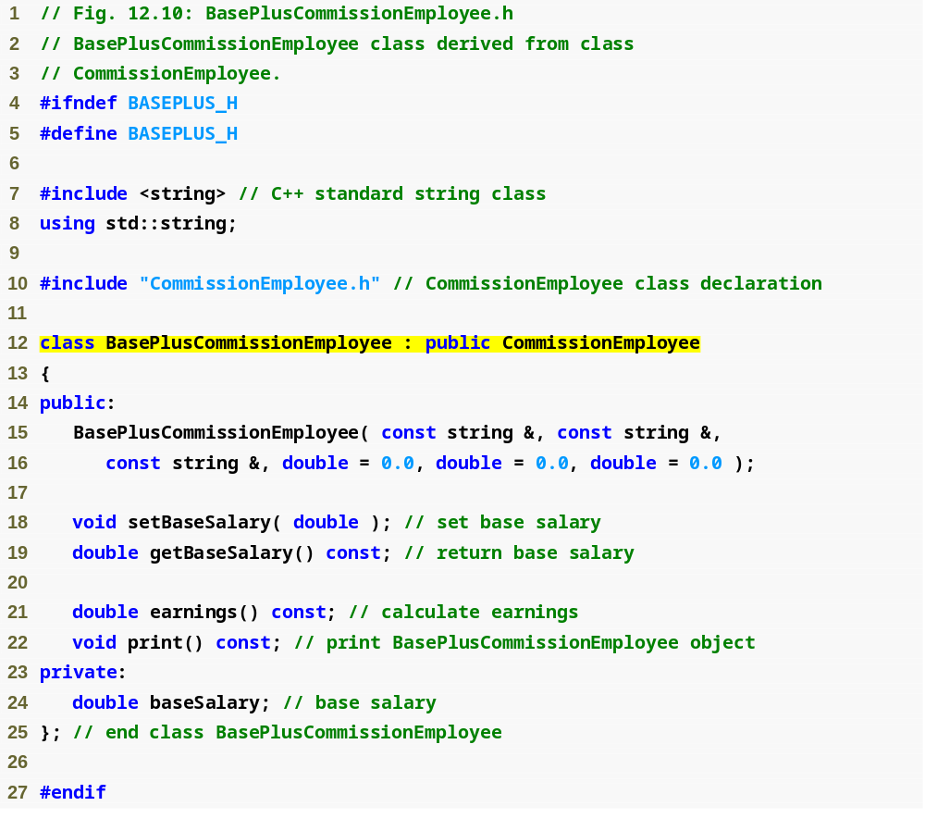
Include the base-class header file in the derived-class header file
Class BasePlusCommissionEmployee derives publicly from class CommissionEmployee
Example 3
BasePlus
Commission
Employee.h
(1 of 1)

Slide 45
Comments – Example 3 Specification (.h)
The colon (:) in line 12 is used to indicate inheritance and public indicates the type of inheritance
  We said with public inheritance the derived class inherits all the members of the base class
    This is true except for the constructor and the destructor (if there were one)
      This means our derived class BasePlusCommissionEmployee must include its own constructor but inherits all other members of the base class CommissionEmployee
  Note that we cannot see the inherited members of CommissionEmployee just by looking at BasePlusCommissionEmployee's source code but:
    they ARE inherited and thus can be used by any object of the BasePlusCommissionEmployee class
  Note that our derived class does redefine earnings() and print() even though they are inherited because we specialized them (redefined them)

Slide 46
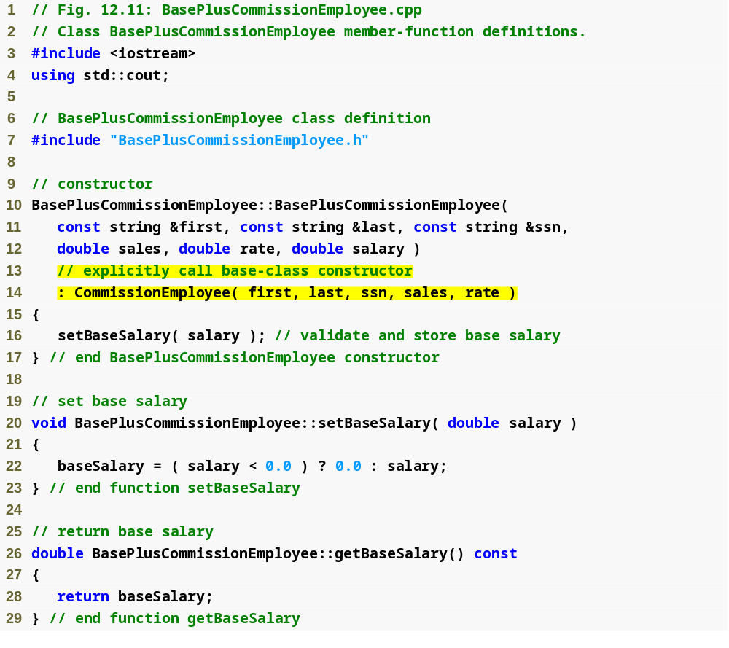
Example 3
BasePlus
Commission
Employee.cpp
(1 of 2)
Initialize base class data member by calling the base-class constructor using base-class initializer syntax

Slide 47
Comments – Example 3 Implementation Part 1 (.cpp)
The implementation for the constructor shows base-class initializer syntax
  This is used to pass arguments to the base class (CommissionEmployee) constructor
  C++ requires that a derived-class constructor call its base class constructor to initialize the base class members that are inherited into the derived class
    If no base class constructor is called using this syntax it will attempt to call the default constructor if there is one
      Since this class does not have a default (no arg) constructor, we would get an error if we did this
      Remember a default constructor with no args is only provided by C++ if the class does not supply any other constructor

Slide 48
Including the base class header file
Note that I included the base class's header file in the derived class's header file (#include <CommissionEmployee.h)
Base class header file must be included in derived class header file for three reasons, the compiler must
  Know that base class exists
    in order to use the base class's name in the constructor or elsewhere
  Know size of inherited data members
    A client program that creates an instance of an object must include the class definition to reserve the proper amount of memory for the object
    With inheritance, a derived class's object's size regarding this depends on the data members declared explicitly in its class definition AND the data members inherited from both its direct and indirect base classes
      Including the base class's definition in the derived class's header allows this to happen (the compiler to correctly determine the memory requirements for the base class's data members that become part of a derived-class object) and thus
  Ensure that inherited class members are used properly
    For example that private base class members aren't directly accessed

Slide 49
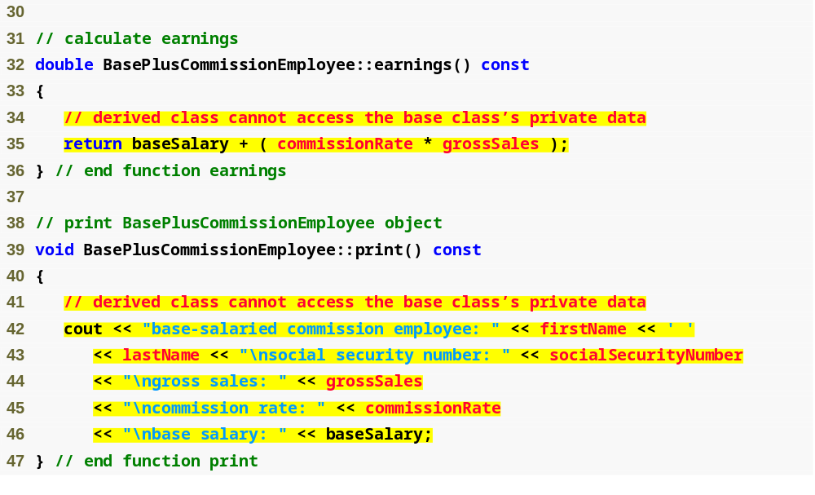
Compiler generates errors because base class’s data member commissionRate and grossSales are private inherited members
Compiler generates errors because the base class’s data members firstName, lastName, socialSecurityNumber, grossSales and commissionRate are private
Example 3
BasePlus
Commission
Employee.cpp
(1 of 2)

Slide 50
Comments – Example 3 Implementation Part 2 (.cpp)
Remember that with public inheritance the derived class can NOT directly access the base class's private members
  So we get errors in both the earnings() function and the print() function
How to fix this?
  Although the derived class cannot directly access private members of the base class it can use public members to modify them
    Let's fix Example 3 so it will work
  Note: we could also use protected members in the base class to avoid this problem which we will do in the next example BUT THIS APPROACH IS BETTER IN MOST CASES

Slide 51
Performance Tip
In a derived-class constructor, initializing member objects and invoking base-class constructors explicitly in the member initializer list:
  prevents duplicate initialization in the case where a default constructor is called, and then data members are modified again in the derived-class constructor’s body.

Slide 52
Linking Process
The linking process requires:
  the object code for all classes used in the program AND the object code of the direct and indirect base classes of any derived classes used in the program
If a client wants to create an application using the class BasePlusCommissionEmployee that is derived from CommissionEmployee:
  When compiling the application, the Client's object code must be linked with the object code for both the derived class and the base class
  The client code is also linked with object code for any C++ standard libraries used
So the client gets to see the specifications and gets access to all implementations it may need

Slide 53
Inheritance & protected data (Example 4)
Example 4
  We can use protected data members to allow the BasePlusCommissionEmployee derived class to directly access the CommissionEmployee base class data members of:
    firstName, lastName, socialSecurityNumber, grossSales, and commissionRate
  Remember we said a base class's protected members can be accessed by:
    the base class's members and friends
    and any derived class's members and friends
Use protected data
  Enable class BasePlusCommissionEmployee to directly access base class data members
  Base class’s protected members are inherited by all derived classes of that base class

Slide 54
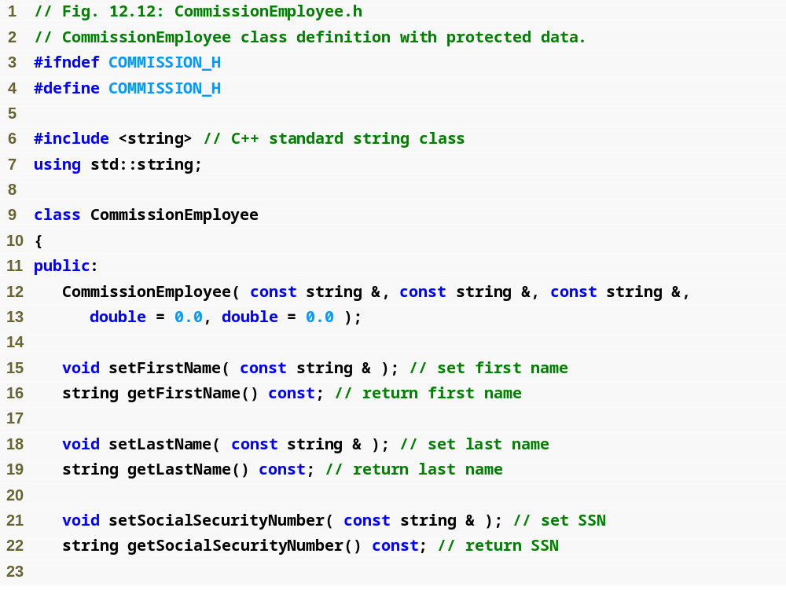
Example 4
Commission
Employee.h
(1 of 2)

Slide 55
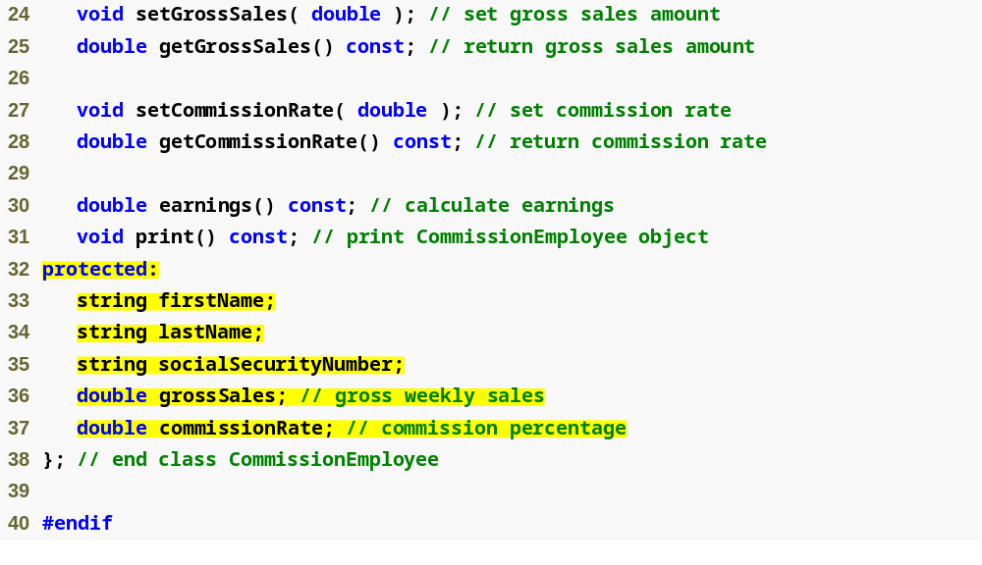
Declare protected data
Example 4
Commission
Employee.h
(2 of 2)

Slide 56
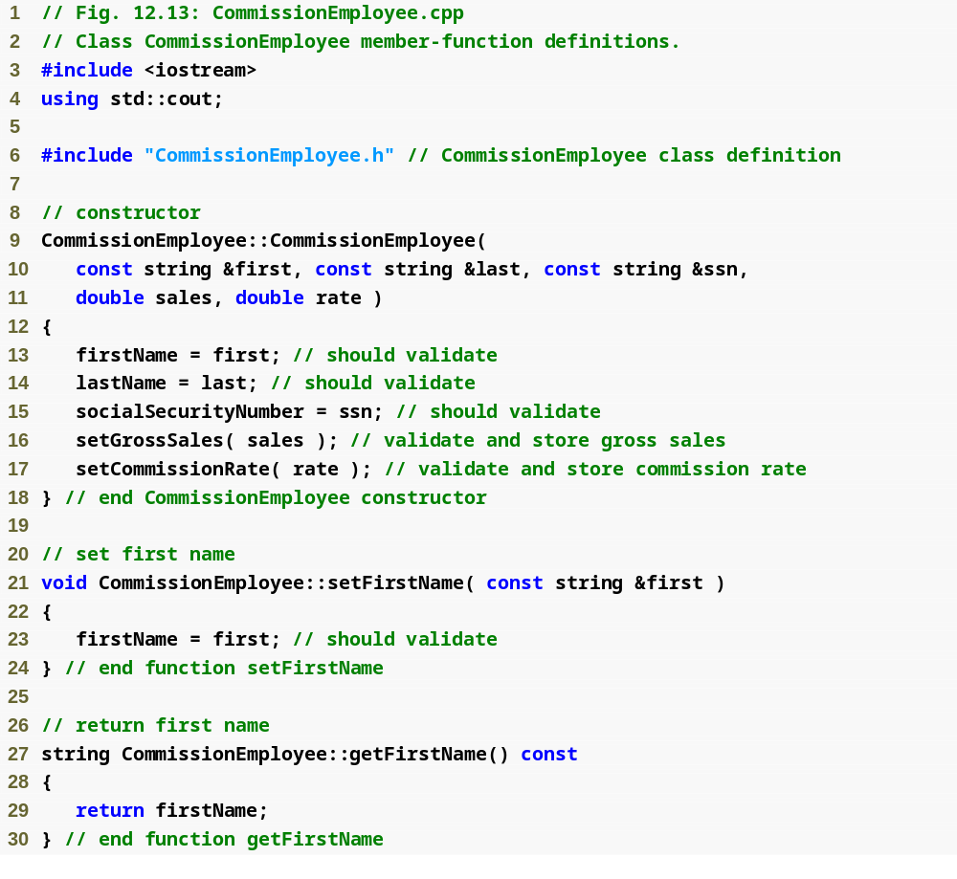
Example 4
Commission
Employee.cpp
(1 of 4)

Slide 57
Example 4
Commission
Employee.cpp
(2 of 4)

Slide 58
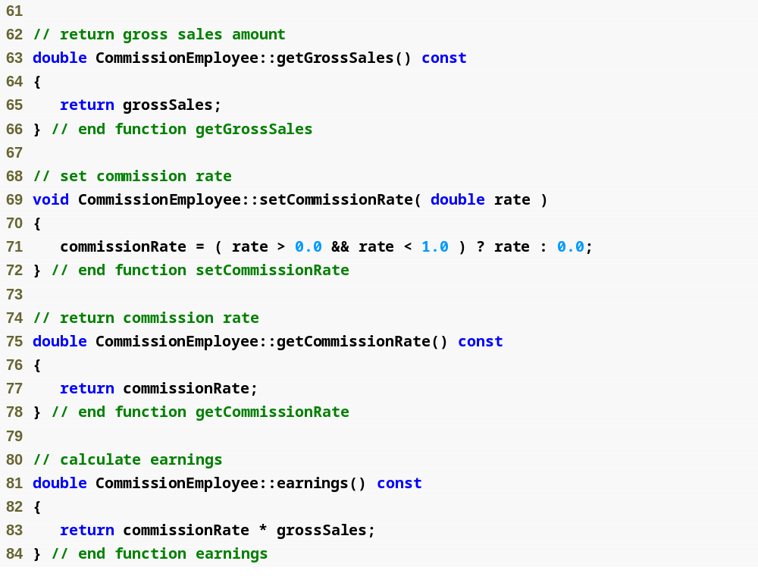
Example 4
Commission
Employee.cpp
(3 of 4)

Slide 59
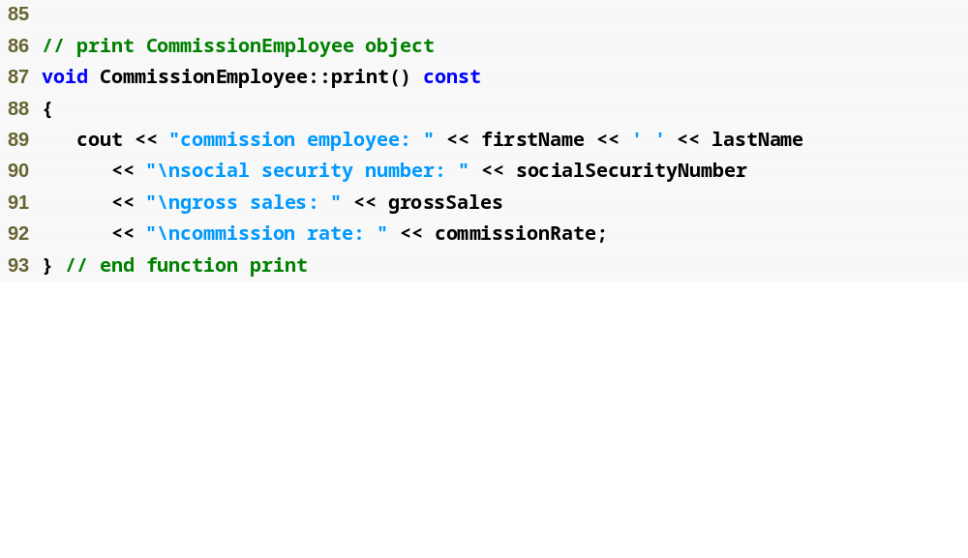
Example 4
Commission
Employee.cpp
(4 of 4)

Slide 60
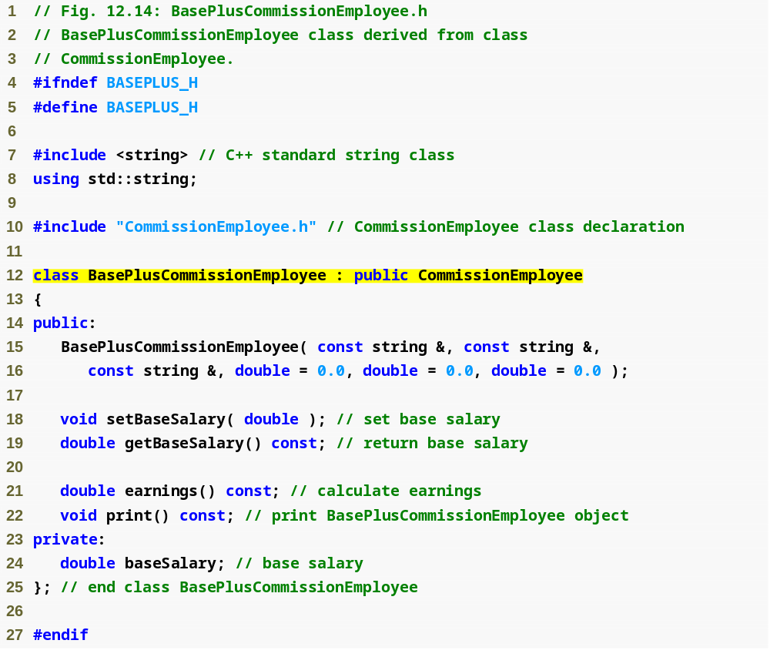
Example 4
BasePlus
Commission
Employee.h
(1 of 1)
BasePlusCommissionEmployee still inherits publicly from CommissionEmployee

Slide 61

Call base-class constructor using base-class initializer syntax
Example 4
BasePlus
Commission
Employee.cpp
(1 of 2)

Slide 62
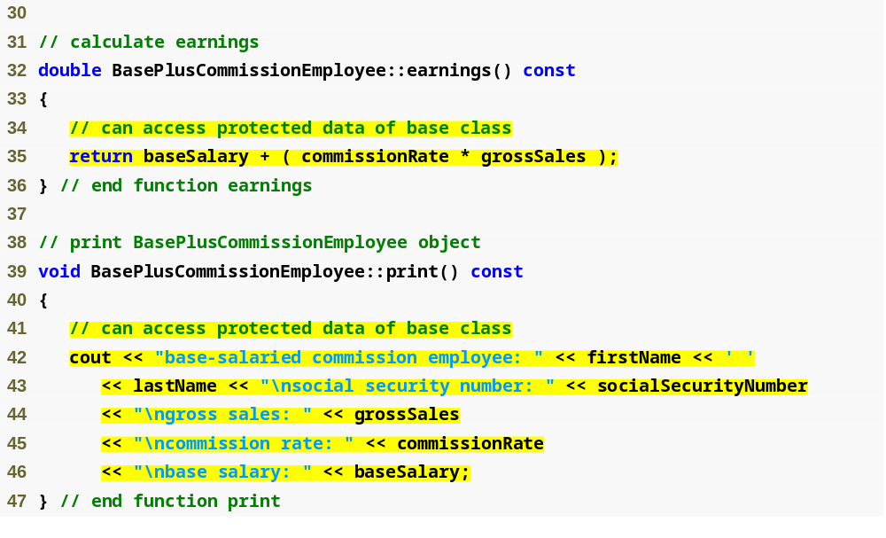
Directly access base class’s protected data
Example 4
BasePlus
Commission
Employee.cpp
(1 of 2)

Slide 63

Example 4
testInheritance2.cpp
(1 of 2)
Note that the output of all the test programs (with and without Inheritance)
are identical
-The advantages of the inheritance is in the code saved by having
the derived class absorb the duplicate members of the base
class
-In addition, this will make maintenance, modifying and
debugging easier and less error prone

Slide 64

Example 4
testInheritance2.cpp
(2 of 2)

Slide 65
Notes on using protected data
Using protected data members
Advantages
  Derived class can modify values directly
    Avoid set/get method call overhead
      Slight increase in performance
  In most cases though, it is better to use private data members to encourage proper software engineering and leave code optimization issues to the compiler
Disadvantages
  Using protected data members causes two serious problems
  No validity checking
    Derived class can assign illegal values to private members since they don’t have to use set functions to access them
  Implementation dependent
    Derived class functions more likely to be written so that they are dependent on base class implementation (base class member variables) if protected is used
      It's better to have the classes be dependent on the base-class services (non-private member functions) than on the actual base class implementation
        if the implementation of the functions change the derived class doesn't have to worry about the changes (if it only uses the functions and not the members)
        but if the private members directly change and the derived class directly accesses them the derived class will also have to change
    Base class implementation changes may result in derived class modifications
      Fragile (brittle) software

Slide 66
Software Engineering Tips
It is appropriate to use the protected access specifier when:
  a base class should provide a service (i.e., a member function) only to its derived classes (and friends), not to other clients.
Declaring base-class data members private (as opposed to declaring them protected):
  enables programmers to change the base-class implementation without having to change derived-class implementations.
When possible, avoid including protected data members in a base class.
  Instead, include non-private member functions that access private data members, ensuring that the object maintains a consistent state.

Slide 67
Inheritance good Software Engineering (Example 5)
Example 5
Reexamine hierarchy
  Use the best software engineering practice
    Declare data members as private
    Provide public get and set functions
    Use get methods to obtain values of data members
  We will have the print() and earnings() functions call the base class functions needed rather than directly accessing base class implementation data
    This means if the base class for some reason decided to change the data member names, the earnings() and print() function definitions of the derived class would not require modification
      These types of changes only change things in the base class not the derived class

Slide 68
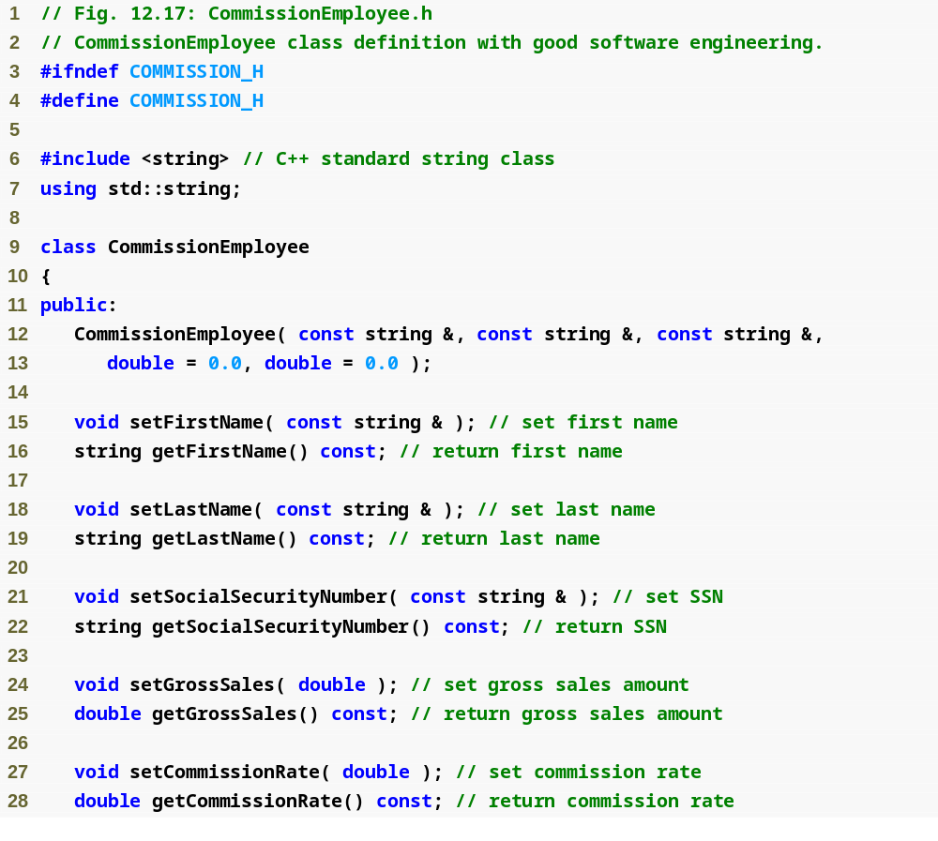
Example 5
Commission
Employee.h
(1 of 2)

Slide 69
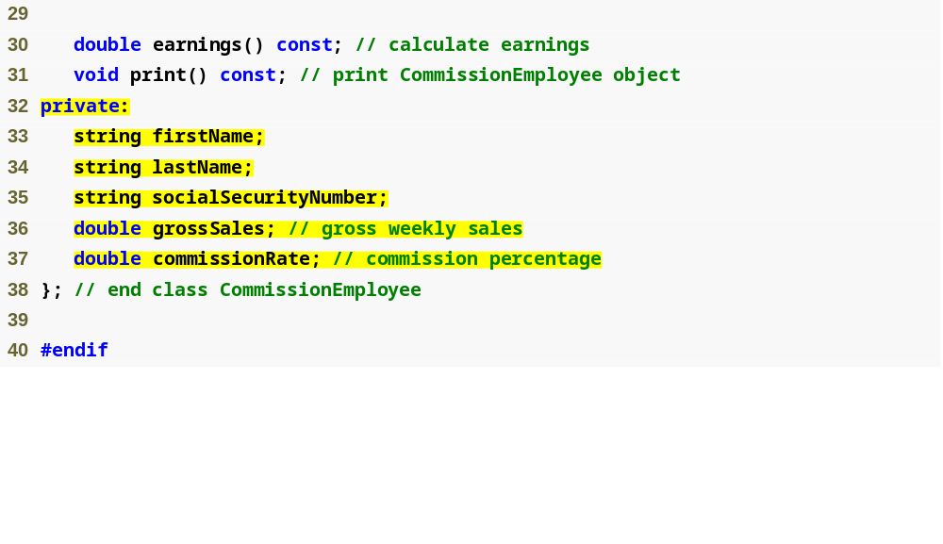
Declare private data
Example 5
Commission
Employee.h
(2 of 2)

Slide 70
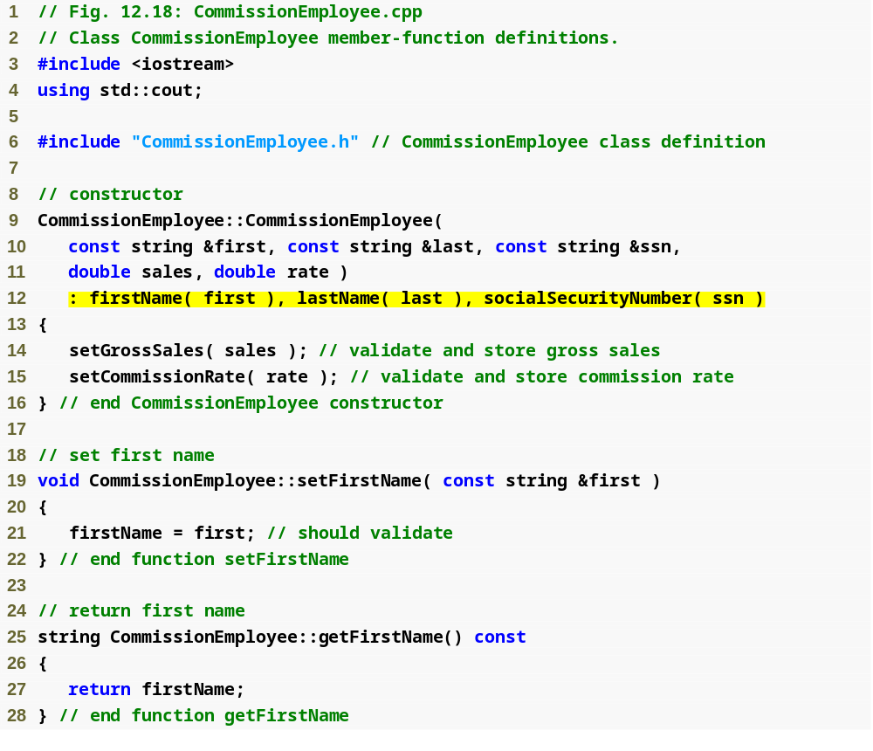
Example 5
Commission
Employee.cpp
(1 of 4)
Use member initializers to set the values of members firstName, lastname and socialSecurityNumber

Slide 71
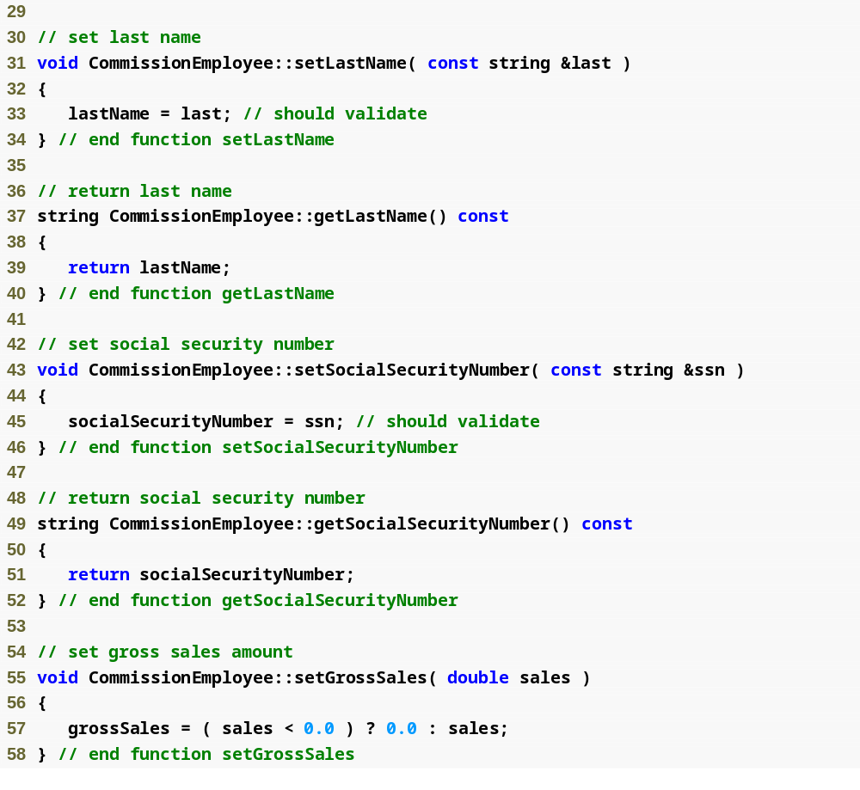
Example 5
Commission
Employee.cpp
(2 of 4)

Slide 72
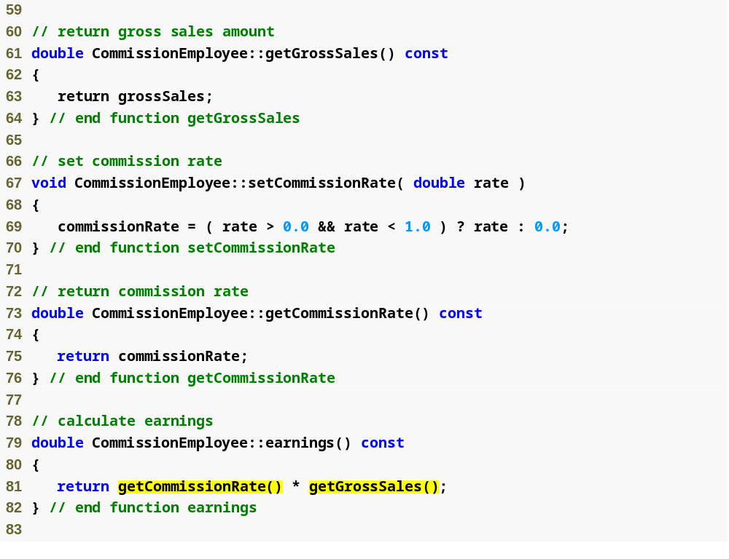
Example 5
Commission
Employee.cpp
(3 of 4)
Use get functions to obtain the values of data members

Slide 73
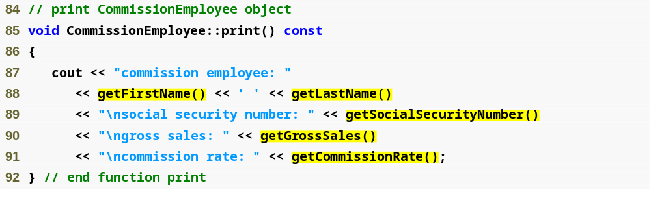
Use get functions to obtain the values of data members
Example 5
Commission
Employee.cpp
(4 of 4)

Slide 74
Performance Tip
Using a member function to access a data member’s value can be slightly slower than accessing the data directly.
  However, today’s optimizing compilers are carefully designed to perform many optimizations implicitly
    (such as inlining set and get member-function calls).
    As a result, programmers should write code that adheres to proper software engineering principles, and leave optimization issues to the compiler.
      A good rule is, “Do not second-guess the compiler.”

Slide 75

Example 5
BasePlus
Commission
Employee.h
(1 of 1)

Slide 76
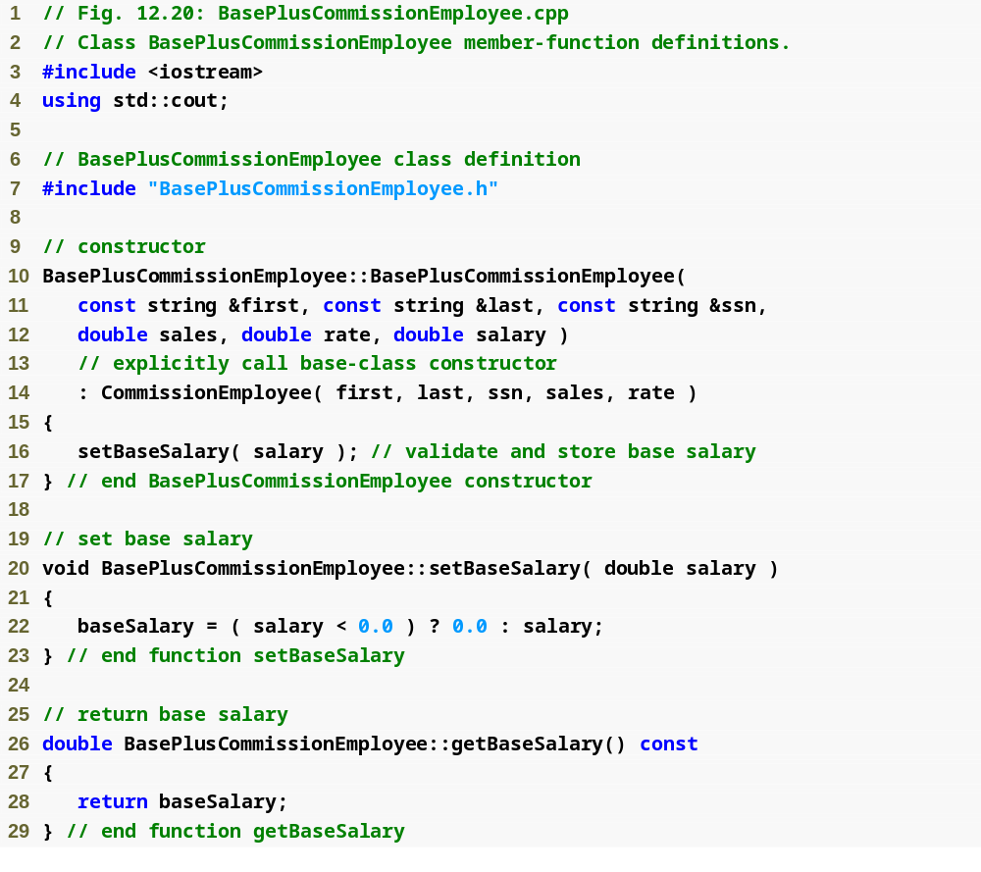
Example 5
BasePlus
Commission
Employee.cpp
(1 of 2)

Slide 77
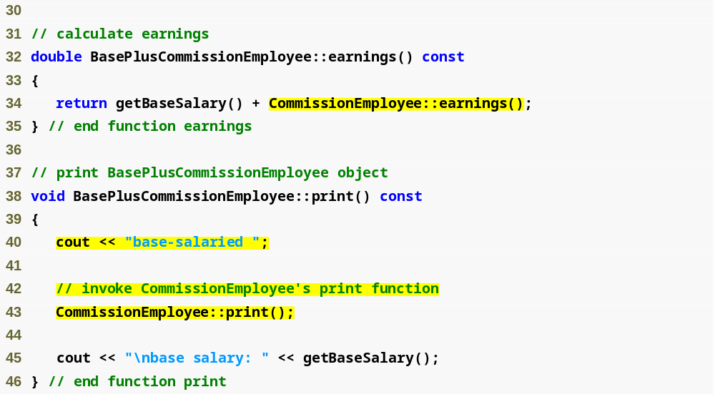
Invoke base class’s earnings function
Invoke base class’s print function
Both earnings() and print() are redefined base class member functions
Note that we also call the getBaseSalary() function
rather than directly access the baseSalary member,
this way if it changes we don't also have to change the
function
Note the syntax used to invoke a redefined base class member function from a derived class, places the base-class name and the binary scope resolution operator (::) before the base-class member function name
Example 5
BasePlus
Commission
Employee.cpp
(2 of 2)

Slide 78
Redefined base class member functions
Redefined base-class member functions are good engineering
  because these functions avoid duplicating code and can call the base class member functions they are redefined from to get additional information
When a base-class member function is redefined in a derived class, the derived-class version often calls the base-class version to do additional work.
  Failure to use the :: operator prefixed with the name of the base class when referencing the base class’s member function causes infinite recursion, because the derived-class member function would then call itself.
Including a base-class member function with a different signature in the derived class hides the base-class version of the function.
  Attempts to call the base-class version through the public interface of a derived-class object in this case result in compilation errors.

Slide 79
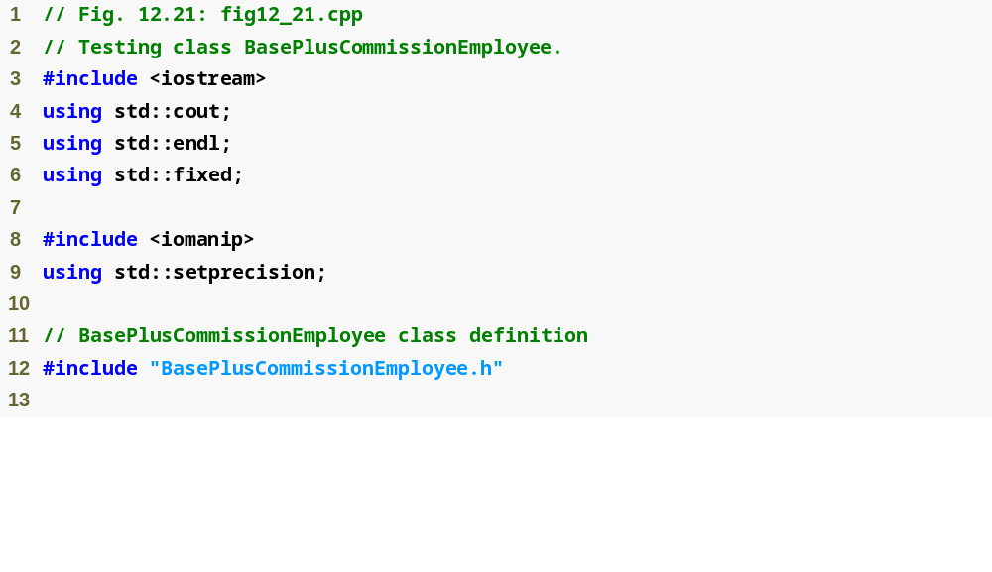
Example 5
testInheritance3.cpp
(1 of 2)

Slide 80
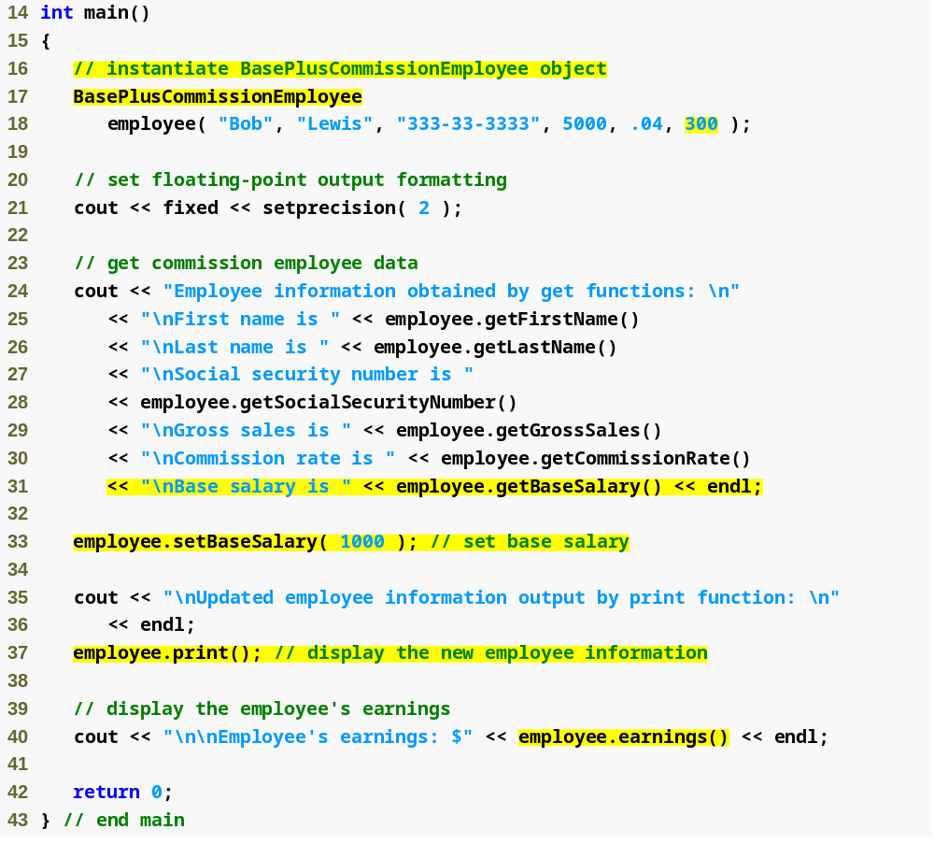
Create BasePlusCommissionEmployee object
Use inherited get methods to access base class private members
Use BasePlusCommissionEmployee get method to access private member
Use BasePlusCommissionEmployee set method to modify private data member baseSalary
Example 5
testInheritance3.cpp
(2 of 2)

Slide 81
Examples 1-5
They all work identically but the best engineered example is Example 5
  You want to start trying to use good software engineering techniques in your code

Slide 82
Constructors, Destructors & Inheritance
Concept: When an object of a derived class is being instantiated: the base class constructor is called before the derived class constructor. When the object of the derived class is destroyed, the derived class destructor is called before the base class destructor.
We know that constructors are automatically called by the compiler whenever an object of a class is created
  The object of the derived class can be regarded as having an object of the base class embedded within it since all of the base class's members are inherited by the derived class
  When an object of the derived class is created the compiler will ALWAYS call the base class constructor before it calls the derived class constructor
    This order is reversed when the object of the derived class is destroyed
  This order permits the derived class constructors to use data or member functions from the base class when they do their work

Slide 83
Constructors, Destructors & Inheritance
Instantiating derived-class objects begins a chain of constructor calls
  Derived-class constructor invokes base class constructor
    Implicitly (by calling the default constructor) or explicitly (via base class member initializer)
    If the base class is derived from another class it too is required to invoke the constructor one up the inheritance change before itself and so on
    The very top Base class of inheritance hierarchy
      is the Last constructor called in chain
      is the First constructor body to finish executing
      Example: CommissionEmployee/BasePlusCommissionEmployee hierarchy
        CommissionEmployee constructor called last
        CommissionEmployee constructor body finishes execution first
      The class at the bottom of the hierarchy is the first constructor called and the last one to finish executing
  Initializing data members
    Each base-class constructor initializes its data members that are inherited by derived class

Slide 84
Software Engineering Observation
When a program creates a derived-class object
  the derived-class constructor immediately calls the base-class constructor
  the base-class constructor’s body executes
  then the derived class’s member initializers execute
  and finally the derived-class constructor’s body executes.
This process cascades up the hierarchy if the hierarchy contains more than two levels.

Slide 85
Constructors, Destructors & Inheritance
Destroying derived-class object
  Chain of destructor calls
    Reverse order of constructor chain
    Destructor of derived-class called first
    Destructor of next base class up hierarchy next
      Continue up hierarchy until final base reached
        After final base-class destructor, object removed from memory
Base-class constructors, destructors, assignment operators (overloaded assignment operators)
  are NOT inherited by derived classes

Slide 86
More Constructors, Destructors & Inheritance
Suppose that we create an object of a derived class where both the base class and the derived class contain objects of other classes (composition – so now we have inheritance and composition).
  When an object of that derived class is created, first the constructors for the base class’s member objects execute
  then the base-class constructor executes
  then the constructors for the derived class’s member objects execute
  then the derived class’s constructor executes.
  Destructors for derived-class objects are called in the reverse of the order in which their corresponding constructors are called.

Slide 87
Base Access Specification
When we created our derived classes we specified what's called a base access specification before the name of the class we were deriving from:
  class Student : public Person
    So public is the base access specification
The base access specification is NOT the same as member access specification
  member access specification: determines the type of access to/for members defined in the class
  base access specification: determines the type of access for inherited members in regard to the base class

Slide 88
public, protected and private Inheritance
We said with inheritance the base class can be executed through public, private, or protected inheritance
  protected and private inheritance are rare and each should only be used if there is a very good reason
Here is a summary of the differences:
  public inheritance
    Base class public members → derived class public members
    Base class protected members → derived class protected members
    Base class private members are not DIRECTLY accessible by the derived class
  protected inheritance (not is-a relationship)
    Base class public and protected members → derived class protected members
    Base class private members are not DIRECTLY accessible by the derived class
  private inheritance (not is-a relationship)
    Base class public and protected members → derived class private members
    Base class private members are not DIRECTLY accessible by the derived class

Slide 89
Base Access Specification
Base Class Access Specification | How members of the base class appear in the Derived class
private | Private members of the base class are inaccessible to the derived class
 | Protected members of the base class become private members of the derived class
 | Public members of the base class become private members of the derived class
protected | Private members of the base class are inaccessible to the derived class
 | Protected members of the base class become protected members of the derived class
 | Public members of the base class become protected members of the derived class
public | Private members of the base class are inaccessible to the derived class
 | Protected members of the base class become protected members of the derived class
 | Public members of the base class become public members of the derived class

Slide 90
Software Engineering with Inheritance
Customizing existing software
  Inheriting from existing classes
    Can include additional members
    Can redefine base-class members
    No direct access to base class’s source code
      Only links to object code
  Independent software vendors (ISVs)
    Develop proprietary code for sale/license
      Available in object-code format
    Users derive new classes
      Without accessing ISV proprietary source code

Slide 91
Software Engineering Tips
At the design stage in an object-oriented system, the designer often determines that certain classes are closely related.
  The designer should “factor out” common attributes and behaviors and place these in a base class
    and then use inheritance to form derived classes, giving them with capabilities beyond those inherited from the base class.
The creation of a derived class does not affect its base class’s source code. Inheritance preserves the integrity of a base class.

